Slide 1
CS 35L-5
Week 2 Lec 1

Slide 2
Linux Commands continued..
pipeline: |
redirection: >, >>, <
ls, cat, head, tail
grep: selects input lines that match given pattern
grep ‘ERROR’ file.txt
wc: word, line, character and byte count
wc -l file.txt

Slide 3
sort, comm and tr
sort: sorts lines of text files
Usage: sort [OPTION]…[FILE]…
comm: compare two sorted files line by line, select/reject lines common to 2 files
Usage: comm [OPTION]…FILE1 FILE2
comm -23 file1 file2
tr: translate or delete characters
Usage: tr [OPTION]…SET1 [SET2]
echo "password a1b2c3" | tr -d [:digit:] -> password abc
echo “abc” | tr [:lower:] [:upper:] -> ABC

Slide 4
sed, test and expr
sed: stream editor, modifies the input as specified by the command(s)
substitution – s/regex/replacement/flags
sed s/day/night/g < oldFile > newFile
echo $PATH | sed s/:.*//
sed 's/<[^>]*>//g' a.html
test: evaluates an expression; exit status = 0(true), 1(false), >1(error)
test 4 -gt 3; equivalent to [ 4 -gt 3 ] !!Spaces around [ and ]!!
expr: evaluates the expression and returns the result
a=$(expr $a + 1)

Slide 5
more sed examples
sed 12,18d file.txt// delete 12-18 lines
sed -n 12,18p file.txt
sed '1~3d' file.txt
sed '1,20 s/Johnson/White/g' file.txt
sed '/pattern/d' file.txt
sed -e ‘1p’ -e ‘3p’ file.txt
sed -n -e '/BEGIN/,/END/p' file.txt
sed '/regexp/!d' file.txt
sed '/./!d' file.txt

Slide 6
Regular Expressions
Quantification
- How many times of previous expression?
- Most common quantifiers: ?(0 or 1), *(0 or more), +(1 or more)
Alternation
- Which choices?
- Operators: [] and |
Hello|World [A B C]
Anchors
- Where?
- Characters: ^ (beginning) and $ (end)

Slide 7
^ start of line
$ end of line
\ turn off special meaning of next character
[ ] match any of enclosed characters, use - for range
[^ ] match any characters except those enclosed in []
. match a single character of any value
* match 0 or more occurrences of preceding character/expression
+ match 1 or more occurrences of preceding
\{x,y\} match x to y occurrences of preceding
\{x\} match exactly x occurrences of preceding
\{x,\} match x or more occurrences of preceding
http://www.robelle.com/smugbook/regexpr.html

Slide 8
Quoting - To preserve literal meaning of special characters
Escape Character \ - Literal value of following character
echo \|
Single Quote - Literal Meaning of all within ‘’
$hello=1
$str=‘$hello’
echo $str -> $hello
Double Quote - Literal meaning except for $, ` and \.
$hello=1
$str=“abc$hello”
echo $str -> abc1
Backquote - execute the command
echo `ls` -> prints result after running ls

Slide 9
Shell Scripting
Shell: The shell provides you with an interface to the UNIX system.
-It gathers input from you and executes programs based on that input.
-When a program finishes executing, it displays that program's output.
Shell-script: A file containing shell commands (and comments - preceded by #) to execute
- The #! First Line (shebang): a way to tell the kernel which shell to use for a script
#!/bin/sh
- Make it executable: chmod +x scriptFile
- Execute: path_to_script/scriptFile or
sh path_to_script/scriptFile

Slide 10
Shell Programming Constructs
Variables
Valid character string [a-zA-Z0-9_] to which a value is assigned
var_name=var_value !!No spaces around =!!
Access using $: echo $var_name
Special Variables: certain characters reserved as special variables
$: PID of current shell
#: number of arguments the script was invoked with
n: nth argument to the script
?: exit status of the last command executed
echo $$; echo $#; echo $2; echo $?;
scalar variable vs array variable:
array_name[index]=value; echo ${array_name[index]}

Slide 11
Accessing Shell Script Arguments
Example:
$ who | grep betsy Where is betsy?
betsy pts/3 Dec 27 11:07
Script:
#! /bin/sh
# finduser --- see if user named by first argument is logged in
who | grep $1
Run it:
$ chmod +x finduser Make it executable
$ ./finduser betsy Test it: find betsy
betsy pts/3 Dec 27 11:07
$ ./finduser benjamin Now look for Ben
benjamin dtlocal Dec 27 17:55

Slide 12
Looping
for var in list_values
do
command 1
..
command n
done
while condition
do
command 1
..
command n
done

Slide 13
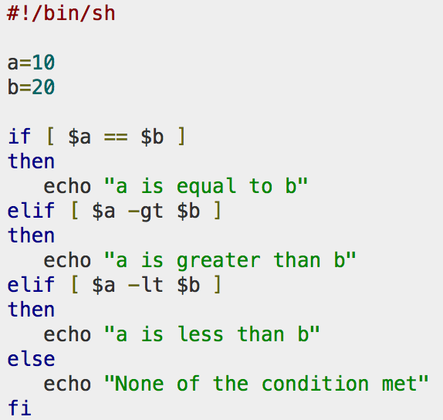
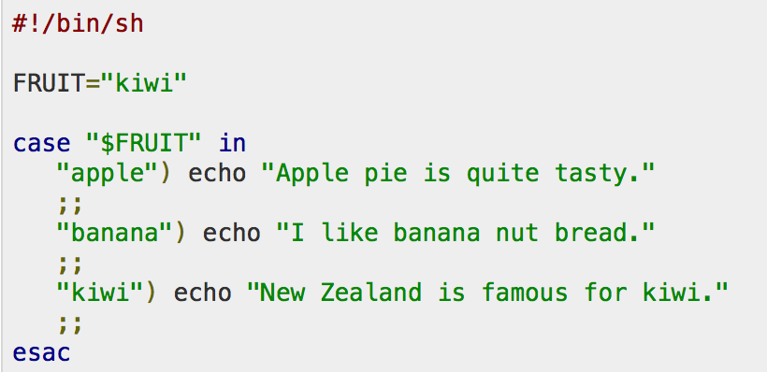
Conditional
if…then…fi
if…then…else…fi
if…then…elif..then…fi
case…esac
Unconditional
break
continue

